Slide 1

Analysis of Unemployment in Republic of India
SRINIVAS ERRAMALLA ,B.tech 3rd Yr
AVANTHI INSTITUTE OF ENGINEERING AND TECHNOLOGY

Slide 2

PROBLEM STATEMENT
This data analysis project aims to investigate the unemployment trends in the Republic of India with a focus on the attributes of age, gender, unemployment status, and time period. By analyzing these variables, the project seeks to uncover patterns and disparities in unemployment rates among different age groups and genders over specific periods. The goal is to provide insights into the demographic factors influencing unemployment and to support the development of targeted policies to address these issues effectively.

Slide 3
Key Areas of Focus:
1. Unemployment Rate Analysis 2. Sectoral Analysis 3. Demographic Analysis 4. Urban vs. Rural Analysis 5. Government Policies and Programs 6. Economic Factors 7. Social and Psychological Impact

Slide 4
Methodology:
1. Data Collection:
- Gathered national and state-level unemployment data from government sources.
- Collected demographic data (age, gender, education) and economic.indicators (GDP growth, inflation) from relevant sources.
2. Data Preparation:
- Cleaned and preprocessed data in Microsoft Excel to ensure accuracy.
- Formatted data for integration into Power BI.

Slide 5
Methodology:
3. Analysis in Power BI: - Integrated cleaned data into Power BI for visualization and analysis. - Utilized DAX for creating custom calculations and visualizations. - Conducted exploratory data analysis to identify trends and correlations.
4. Reporting and Visualization: - Created interactive dashboards and reports in Power BI. - Visualized unemployment rates, demographic insights, and policy impacts. - Generated actionable recommendations based on analysis findings.

Slide 6

WHO ARE THE END USERS?
1. Government Agencies 2. Policymakers 3. Economists 4. Researchers 5. Labor Market Analysts 6. Social Scientists 7. Educational Institutions 8. Non-Governmental Organizations (NGOs) 9. Media Outlets 10. Job Seekers

Slide 7

Technology Used
1. Power BI - For data visualization, dashboard creation, and interactive reporting. 2. Microsoft Excel - For initial data cleaning, preprocessing, and basic analysis. 3. DAX (Data Analysis Expressions) - For creating custom calculations and measures within Power BI.

Slide 8
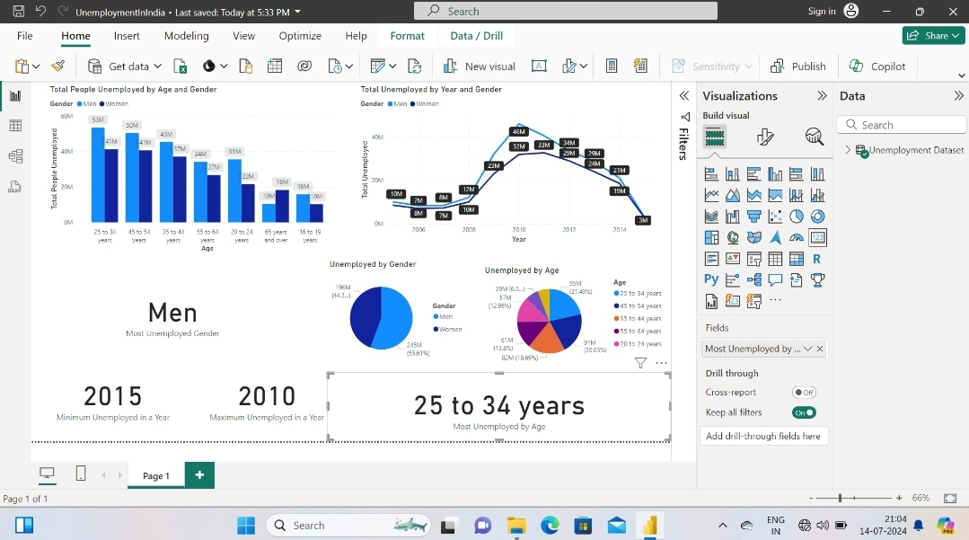
RESULTS
[Add screen shots of your code ]
Demo Link

Slide 9
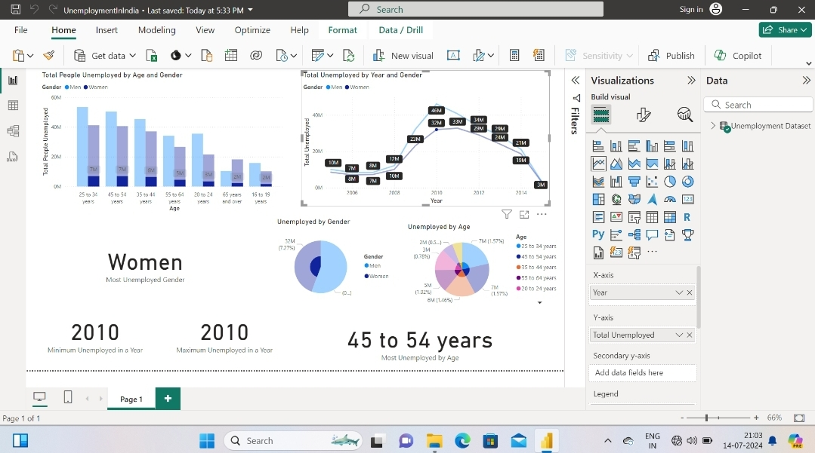
RESULTS

Slide 10
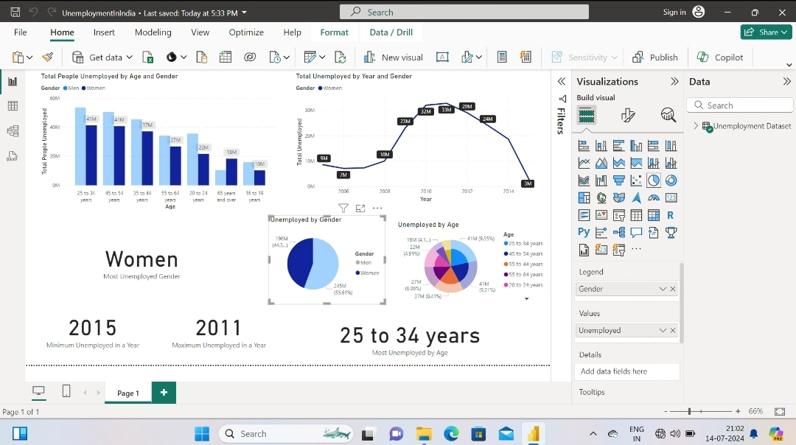
RESULTS

Slide 11
All the data analysis performed on the Unemployment in Republic India dataset is here:
https://app.powerbi.com/view?r=eyJrIjoiYmNkNTM1ZmQtMTNjNy00MjY5LThiM2YtMjA4NjZiNWEwMDI0IiwidCI6ImMxNTc4MDhhLWU1MDItNGFjOC1iM2ZmLTI2OTQxMGE4ZWZlMyJ9

Slide 12
Thank you
.
.

